Slide 1
MSc Artificial Intelligence
Knowledge Engineering
Week 1: Logic in AI
Notes:
This colour bar is to be used for Artificial Intelligence

Slide 2
Logical Reasoning
Einstein’s Riddle
There are five houses.
The Englishman lives in the red house.
The Spaniard owns the dog.
Coffee is drunk in the green house.
The Ukrainian drinks tea.
The green house is immediately to the right of the ivory house.
The Old Gold smoker owns snails.
Kools are smoked in the yellow house.
Milk is drunk in the middle house.
The Norwegian lives in the first house.
The man who smokes Chesterfields lives in the house next to the man with the fox.
Kools are smoked in the house next to the house where the horse is kept.
The Lucky Strike smoker drinks orange juice.
The Japanese smokes Parliaments.
The Norwegian lives next to the blue house.
Who drinks water?
Who owns the zebra?
5 | 3 |  |  | 7
6 |  |  | 1 | 9 | 5
 | 9 | 8 |  |  |  |  | 6
8 |  |  |  | 6 |  |  |  | 3
4 |  |  | 8 |  | 3 |  |  | 1
7 |  |  |  | 2 |  |  |  | 6
 | 6 |  |  |  | ? | 2 | 8
 |  |  | 4 | 1 | 9 |  |  | 5
 |  |  |  | 8 |  |  | 7 | 9

Slide 3
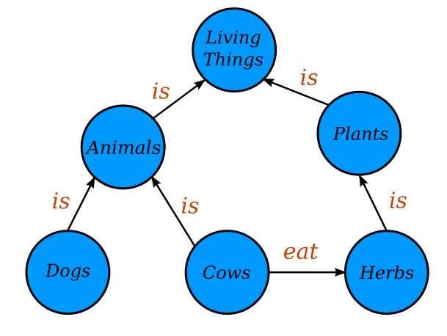
Graphical Representations of Knowledge
https://commons.wikimedia.org/wiki/File:Conceptual_Diagram_-_Example.svg
Original image by Jayarintha, licensed under the Creative Commons Attribution-Share Alike 4.0 International license.

Slide 4

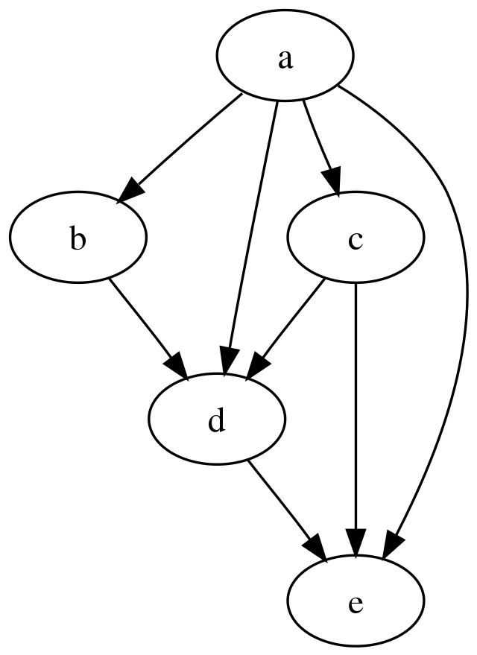
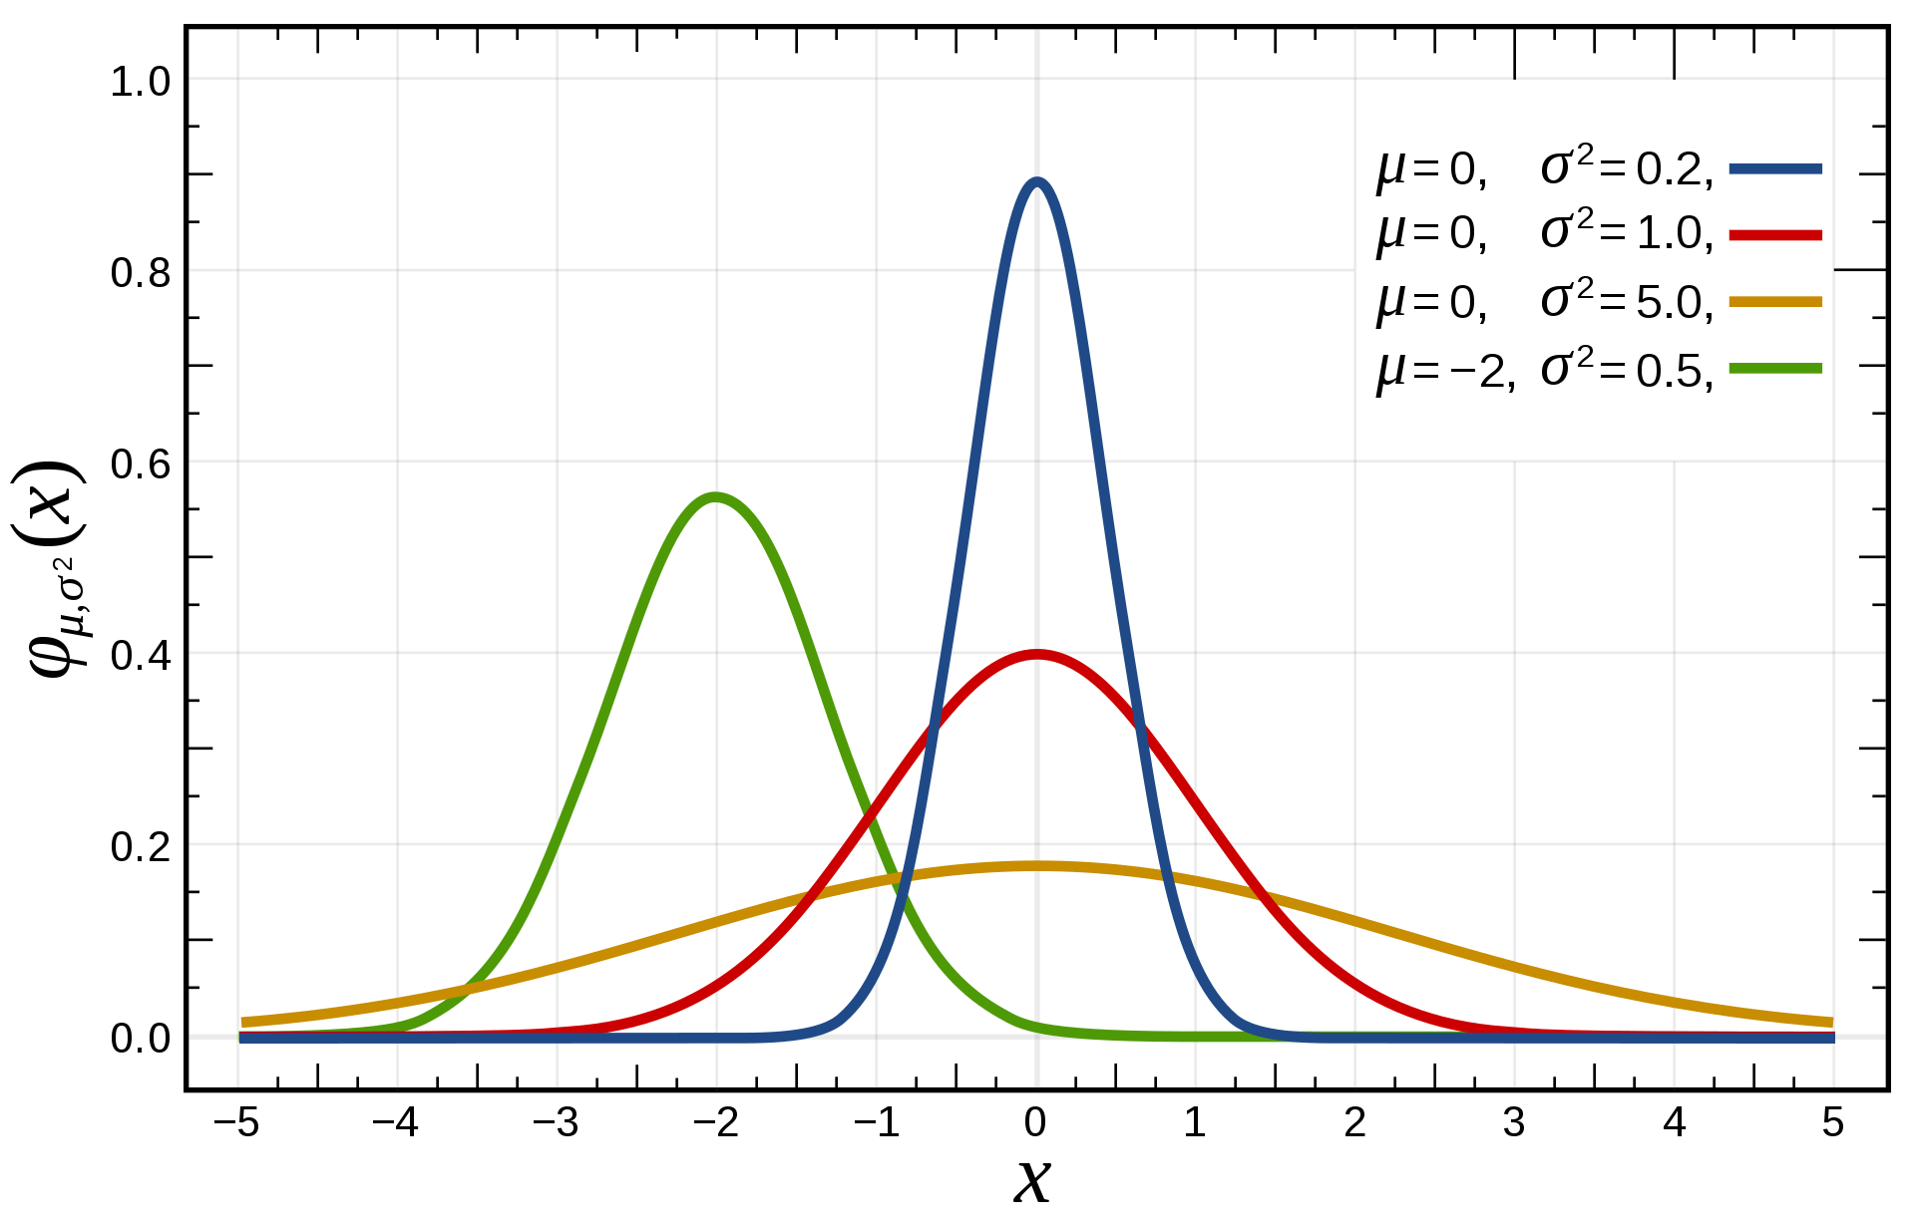
Causal Reasoning
If it is raining I carry an umbrella
It isn’t raining
Therefore …
It is raining.
Everyone is carrying an umbrella.
Therefore, umbrellas cause rain.

Slide 5
Learning Outcomes
Successful students will be able to:
Gain a systematic understanding of knowledge, principles and procedures of knowledge engineering
Demonstrate a critical awareness and evaluation of current and complex issues and developments in knowledge engineering
Demonstrate critical understanding of research techniques in knowledge engineering and ability to critically evaluate them
Demonstrate innovative application of the knowledge, principles and procedures of knowledge engineering in making sound judgements and proposing new hypotheses

Slide 6
Outline Syllabus
Logic
Propositional logic
First order logic
Natural Deduction
Automated Reasoning
Knowledge and knowledge representation
Knowledge Bases
Knowledge Graphs
Large Language Models
Reasoning under Uncertainty
Probabilities, conditional independence;
Bayesian networks
Causal Reasoning (if time)

Slide 7
How the Course will be Taught
Lectures will be kept short-ish and single topic
There are extensive written notes on canvas. You need to read these.
Lots of problems to work though – some paper-based
Plenty of live coding
We will code almost everything ourselves
Python libraries for this are bad/nonexistent
Coding develops understanding
Learn a little more Python

Slide 8
Assessment
Single Assessment due Monday 9/16 December at 0900.
Released at 0900 on Wednesday this week – we will have a session to introduce the assessment and allow you to ask questions and start work on it
Every week will include one session when you can ask questions and work on the assessment
The exercises and assessments are chosen to test your skills and understanding, not to test your domain knowledge

Slide 9
Can you solve them?
Einstein’s Riddle
There are five houses.
The Englishman lives in the red house.
The Spaniard owns the dog.
Coffee is drunk in the green house.
The Ukrainian drinks tea.
The green house is immediately to the right of the ivory house.
The Old Gold smoker owns snails.
Kools are smoked in the yellow house.
Milk is drunk in the middle house.
The Norwegian lives in the first house.
The man who smokes Chesterfields lives in the house next to the man with the fox.
Kools are smoked in the house next to the house where the horse is kept.
The Lucky Strike smoker drinks orange juice.
The Japanese smokes Parliaments.
The Norwegian lives next to the blue house.
Who drinks water?
Who owns the zebra?
5 | 3 |  |  | 7
6 |  |  | 1 | 9 | 5
 | 9 | 8 |  |  |  |  | 6
8 |  |  |  | 6 |  |  |  | 3
4 |  |  | 8 |  | 3 |  |  | 1
7 |  |  |  | 2 |  |  |  | 6
 | 6 |  |  |  | ? | 2 | 8
 |  |  | 4 | 1 | 9 |  |  | 5
 |  |  |  | 8 |  |  | 7 | 9

Slide 10
Exercise: Are you Logical?

Slide 11
What reasoning abilities did you use?
Do these tasks require intelligence?
What do they have in common?
Knowledge acquired incrementally
When new knowledge is discovered, have to revisit old knowledge to draw conclusions
Can we write computer programs to solve them?
Can we write one computer program that will solve them all?
Why are games like these relevant to real-world problems?

Slide 12
Introduction
Why, in an era of big data, do we need to study logic?
Are models learned from data always correct?
What if we need provably correct results?
True intelligence needs to be able to reason rigourously.

Slide 13
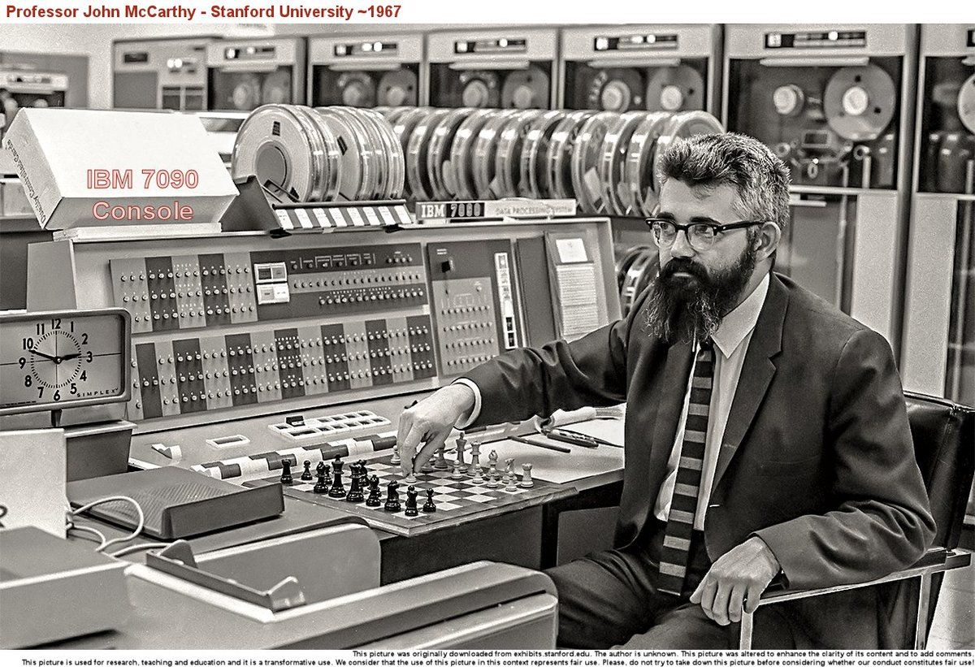
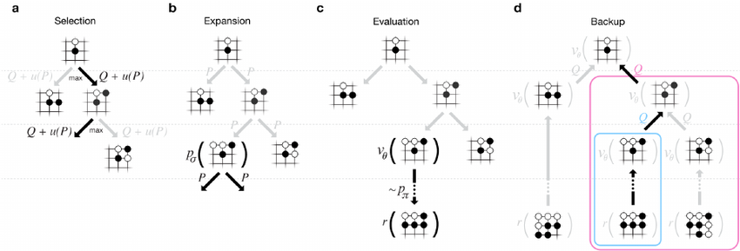
Symbol Manipulation and Intelligence
Early AI researchers regarded reasoning as central to intelligence
Minsky, McCarthy et al placed great emphasis on symbol manipulation
Expert systems were very popular in the 1970s
Why?
And why did symbolic AI "fail"?
Lots of current effort to get ML systems to do symbol manipulation
AlphaGo, AlphaFold both include elements of symbolic reasoning

Slide 14
Logic and Intelligence
“If intelligence requires reasoning
And logic is the study of reasoning
Then…?”
A more cliched example:
Socrates is a man
All men are mortal
…
A deductive truth.
Should AI systems be able to do this?

Slide 15
MSc Artificial Intelligence
Knowledge Engineering
15 November 2023
Notes:
This colour bar is to be used for Artificial Intelligence

Slide 16
Propositional Logic
Humans know facts
- It is colder in the winter than in the summer.
- Mount Everest is the tallest mountain in the world.
- Water makes you wet.
Facts are grounded: we know what a mountain is
How do these facts differ from data?

Slide 17
Propositional Logic
Humans can reason over facts
We can make decisions and draw conclusions
Can we get computers to do the same?
Computers require a formal language: Logic
Logic – the study of correct reasoning- will allow us to formally represent facts and reason about them
Propositional Logic is a simple form of logic that allows us to do just this

Slide 18
Propositions
A proposition is a statement that can be True or False
It is colder in the winter than in the summer.
Mount Everest is the tallest mountain in the world.
Water makes you wet.
A Premise is a stated proposition and is like an axiom
A Conclusion is derived purely from the premise
Socrates is a man [Premise]
All men are mortal [Premise]
Therefore, Socrates is mortal [Conclusion]

Slide 19
Connectives
“Water makes you wet” is an atomic proposition
We can connect these together to get new compound propositions
The car is blue and fuelled by petrol (The car is blue and the car is fuelled by petrol)
Books have hard or soft covers (Books have hard covers or books have soft covers)
If the sun is shining then it is daytime (If the sun is shining then it is daytime)

Slide 20
Correctness
If we use correct reasoning, if the premises of an argument are true then its conclusion must be True
Socrates is a man
All men are mortal
Therefore Socrates is mortal
Is our reasoning correct:
Some apples are red
All apples are tasty
Therefore, all red apples are tasty

Slide 21
Validity and Soundness
Is our reasoning correct:
Some apples are red
Some apples are tasty
Therefore, some red apples are tasty
This is an INVALID argument
Is our reasoning correct:
All apples are red
Some apples are tasty
Therefore, some red apples are tasty
This is VALID but is not SOUND
CORRECT DEDUCTIVE REASONING MUST BE BOTH VALID AND SOUND

Slide 22
Exercise: Elementary, my dear Watson

Slide 23
MSc Artificial Intelligence
Knowledge Engineering
15 November 2023
Notes:
This colour bar is to be used for Artificial Intelligence

Slide 24
Formal Propositional Logic
Humans are excellent at reasoning using natural language, but machines are not.
To automate deductive reasoning, we need to reduce it to symbol manipulation
One symbol to represent each atomic proposition
Each symbol can be True or False

Slide 25
Making Logical Arguments Formal
If it is not raining and I am going outdoors then I do not take a coat or an umbrella.
What are the atomic propositions?
R: It is raining
O: I am going outdoors
C: I will take a coat
U: I will take an umbrella
Each can be True or False

Slide 26
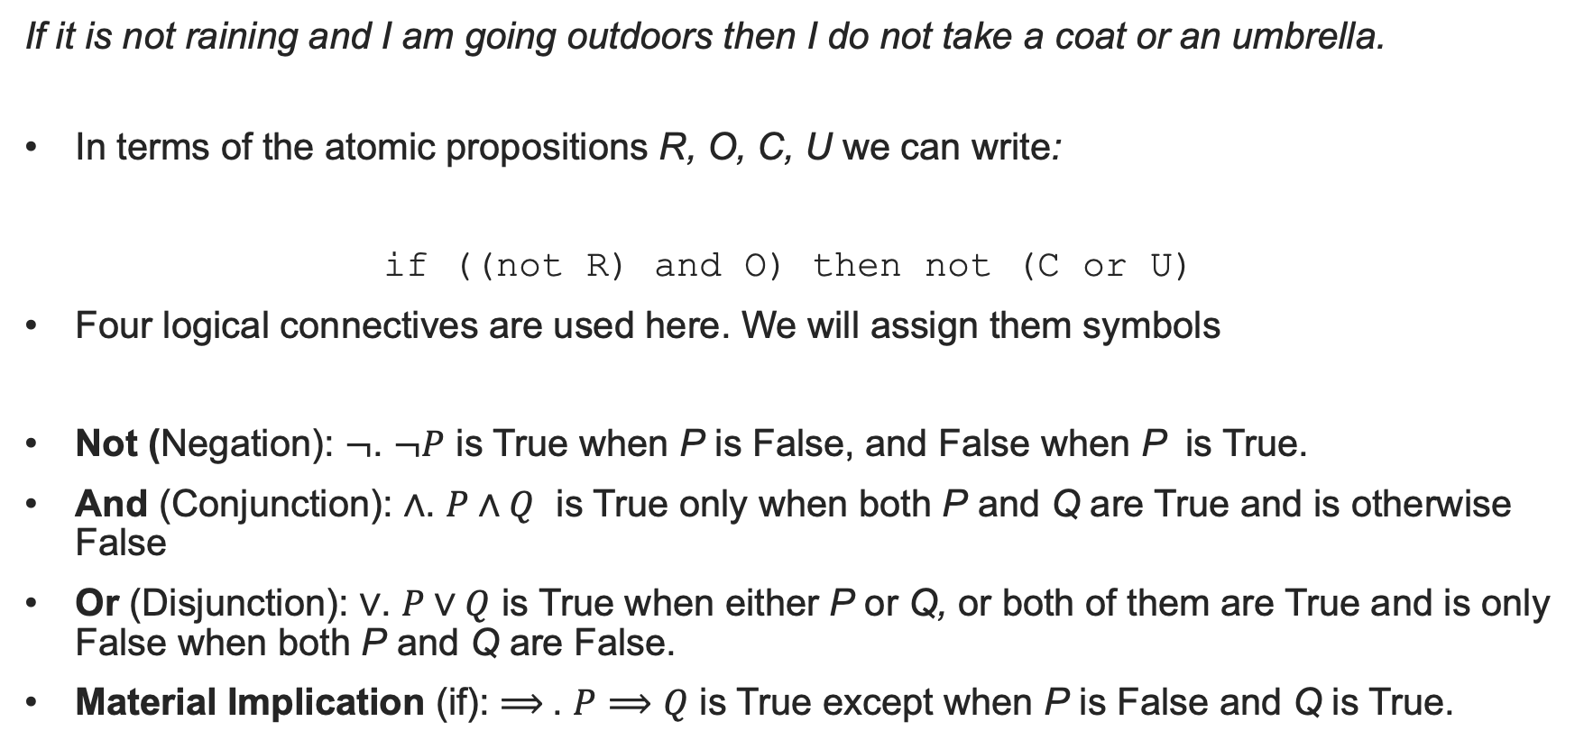
Logical Connectives
If it is not raining and I am going outdoors then I do not take a coat or an umbrella.
In terms of the atomic propositions R, O, C, U we can write:
if ((not R) and O) then not (C or U)
Four logical connectives are used here. We will assign them symbols
Not (Negation): $¬$. $¬P$ is True when P is False, and False when P is True.
And (Conjunction): $∧$. $P∧Q$ is True only when both P and Q are True and is otherwise False
Or (Disjunction): $∨$. $P∨Q$ is True when either P or Q, or both of them are True and is only False when both P and Q are False.
Material Implication (if): $⟹$. $P⟹Q$ is True except when P is False and Q is True.

Slide 27
Truth Tables
The effect of Logical connectives is best illustrated by their Truth Tables
A Truth table tells us whether a Compound proposition is True or False depending on the Truth of the compound propositions
Is the statement “if it is cold I wear a hat” True or False if the statements “I am wearing a hat” and “it is not cold” are both true?
Understanding these will help us to model our knowledge using propositions

Slide 28
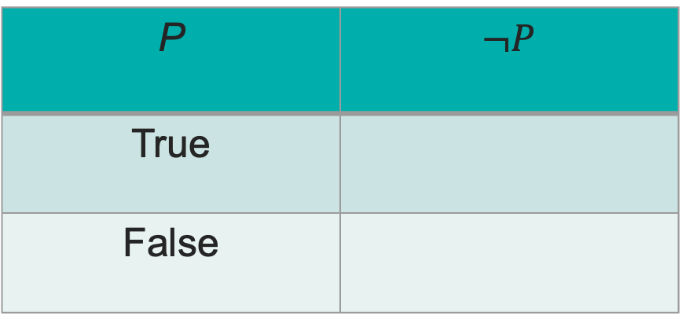
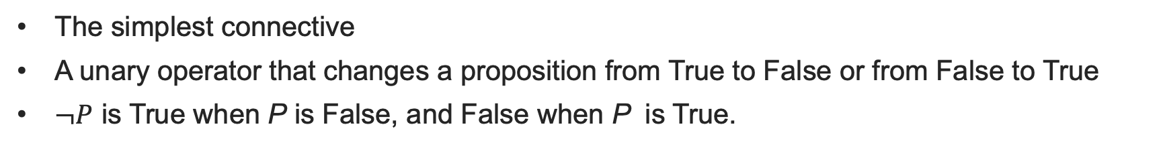
Negation (Not)
The simplest connective
A unary operator that changes a proposition from True to False or from False to True
$¬P$ is True when P is False, and False when P is True.
P | $¬P$
True
False

Slide 29
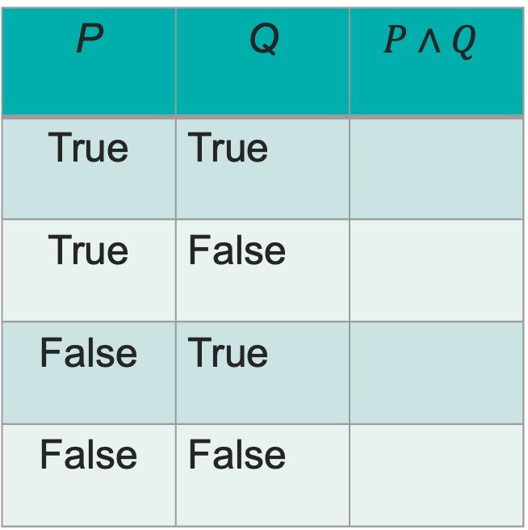
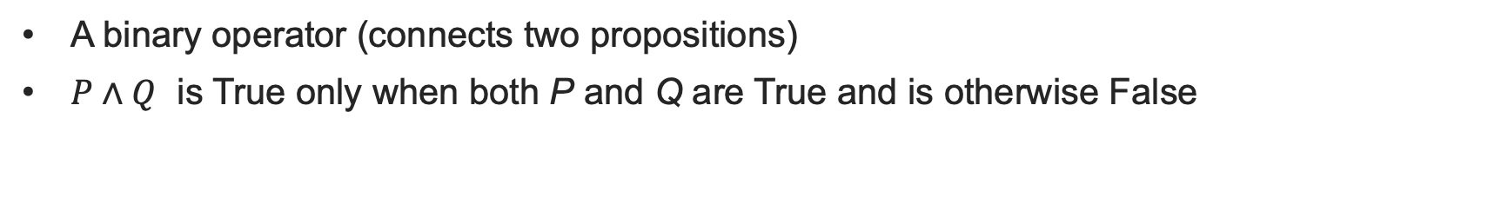
Conjunction (And)
A binary operator (connects two propositions)
$P∧Q$ is True only when both P and Q are True and is otherwise False
P | Q | $$P∧Q$$
True | True
True | False
False | True
False | False

Slide 30

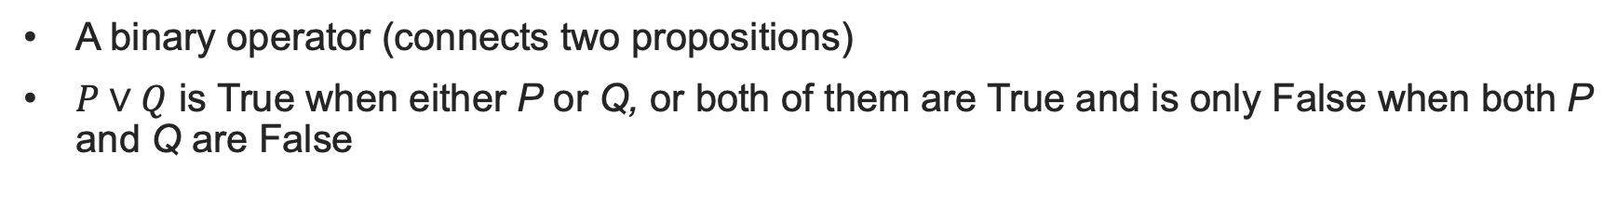
Disjunction (Or)
A binary operator (connects two propositions)
$P∨Q$ is True when either P or Q, or both of them are True and is only False when both P and Q are False
P | Q | $$P∨Q$$
True | True
True | False
False | True
False | False

Slide 31


Material Implication
P | Q | $$P⟹Q$$
True | True
True | False
False | True
False | False
More subtle
$P⟹Q$ is read as “if P then Q”.
Not the same as if..then in programming
No native Python operator.
Can you write a lambda function implies(P,Q)?

Slide 32
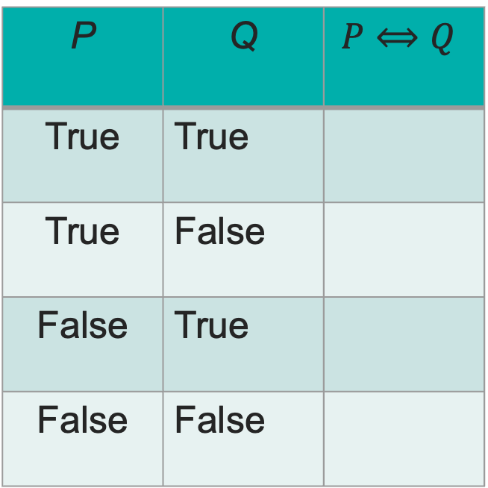
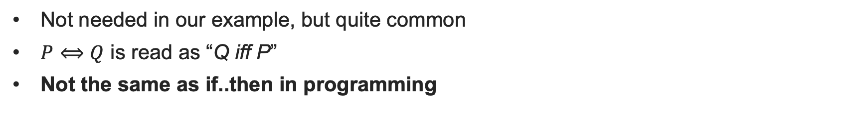
Biconditional
Not needed in our example, but quite common
$P⟺Q$ is read as “Q iff P”
Not the same as if..then in programming
P | Q | $$P⟺Q$$
True | True
True | False
False | True
False | False

Slide 33
Back to our example
If it is not raining and I am going outdoors then I do not take a coat or an umbrella.
if ((not R) and O) then not (C or U)
Exercise: Can you compute the Truth Table for this?

Slide 34
R | O | C | U
T | T | T | T
T | T | T | F
T | T | F | T
T | T | F | F
T | F | T | T
T | F | T | F
T | F | F | T
T | F | F | F
F | T | T | T
F | T | T | F
F | T | F | T
F | T | F | F
F | F | T | T
F | F | T | F
F | F | F | T
F | F | F | F

Slide 35
Exercise: Formal Dinners

Slide 36
MSc Artificial Intelligence
Knowledge Engineering
15 November 2023
Notes:
This colour bar is to be used for Artificial Intelligence

Slide 37
Knowledge Bases
We have now studied enough knowledge to build a knowledge base.
What exactly do we mean by this?
We introduce the concept of an intelligent agent
The agent lives in some abstract world
A chess board
A Roomba
A medical database
The agent has a goal that it must achieve.

Slide 38
How can agents achieve their goals?
Examples of agent goals:
Capture the opponent’s King
Vacuum the entire floor area
Find a combination of medicines for a set of symptoms
The agent must be able to
Observe its environment
The opponent’s King is on square E8
The cat’s bed is in the corner by the heater
Medicines X addresses disease Y
Ask question about its environment to determine new knowledge
If I move my knight to A6, what could happen?
Medicines A and B address diseases X and Y but should not be taken together
Reason over the knowledge to ask a set of questions that enable decisions to be taken that achieve the goal

Slide 39
Knowledge Bases
A knowledge base records what the agent knows as a set of propositions
It may contain some prior information (premises)
It is written in formal notation to enable computation
The agent can update it as it discovers new things about the world
The agent aims to find one or more models that make the knowledge base True
Let’s develop an example:

Slide 40
A Familiar Riddle
Ahmed, Niamh, and Xin are three friends. They went for dinner together. Each of them ordered a main course (stew, daal, falafel) and a dessert (ice cream, apple pie, cheesecake. They each ordered a different main course and a different dessert. Use the following information to deduce who ordered what:
1. The person who ordered the stew did not order the apple pie
2. Niamh ordered the Dhal
3. Ahmed ordered the ice cream or the apple pie
4. Xin did not order either the ice cream or the cheesecake
5. The person who ordered the ice cream did not order the falafel
Can you formalize this?

Slide 41
MSc Artificial Intelligence
Knowledge Engineering
15 November 2023
Notes:
This colour bar is to be used for Artificial Intelligence

Slide 42
Proofs in Logic
All men are mortal
Socrates is a man
Therefore Socrates is mortal
We claim that this is sound and valid argument, but how do we know this?
Soundness is a matter of the truth of the propositions
Validity is whether the reasoning is correct
How can we unambiguously determine the validity of an argument?

Slide 43
Truth Tables
C | J | C=>J
T | T | T
T | F | F
F | T | T
F | F | T
If it is cold, I wear a jacket
It is cold
Therefore, I wear a jacket
In symbols:

Slide 44
Model Checking
Each line of the truth table is called a model
All arguments can be rigourously checked by enumerating all possible models
An argument is valid iff there is at least one model for which all of the premises are True and the conclusion is True
This is known as model checking
The gold standard, but nearly always impractical

Slide 45
Model Checking
One way around the combinatorial explosion problem is to identify common parts of an argument, model check those, and then use them as part of a larger argument
Consider our earlier argument (written in sequent form):
We have verified this by truth table and can therefore take it as proven as rigorously as possible (semantically correct). We denote this as:
This is known as modus ponens (method of affirming) and is widely used as the basis for automated reasoning.

Slide 46
Truth Tables
C | J | C=>J
T | T | T
T | F | F
F | T | T
F | F | T
If it is cold, I wear a jacket
I am not wearing a jacket
Therefore, it is not cold
In symbols:
Modus Tollens (method of removing by taking away)

Slide 47
Truth Tables
C | J | C=>J
T | T | T
T | F | F
F | T | T
F | F | T
If it is cold, I wear a jacket
I am wearing a jacket
Therefore, it is cold
In symbols:
Affirming the consequent, or fallacy of the converse

Slide 48
Truth Tables
C | J | C=>J
T | T | T
T | F | F
F | T | T
F | F | T
If it is cold, I wear a jacket
It is not cold
Therefore, I am not wearing a jacket
In symbols:
Denying the antecedent or fallacy of the inverse

Slide 49
Natural Deduction
Truth tables are impractical for larger problems
15 variables – 2¹⁵ = 32,768 models is feasible
50 variables is challenging!
We could simplify by exploiting constraints and check only models that we cannot immediately rule out
Not always obvious…
Can we instead formalize deductive reasoning?

Slide 50
Natural Deduction
Model checking can be used to determine inference rules
These can be used to construct an argument to prove or disprove a proposition
Simple example: if P^Q is True, is P=> Q True?

Slide 51


Example of a Formal Proof
Step |  | Inference Rule | Premises used

Slide 52
Common Inference Rules
P | Q
T | T
T | F
F | T
F | F

Slide 53
A more complex Proof
Step |  | Inference Rule | Premises used

Slide 54
Some more Natural Deduction
OR Introduction
Step |  | Inference Rule | Premises used

Slide 55
Proving Invalid Arguments
If you’re finding it hard to prove an argument, that could be because it is invalid!
You see if this is the case, you might try:
Proving the negation of the conclusion
Derive a contradiction by proving both the conclusion and its negation, or by deriving the negation of one of the premises

Slide 56
MSc Artificial Intelligence
Knowledge Engineering
15 November 2023
Notes:
This colour bar is to be used for Artificial Intelligence

Slide 57
Exercise: Natural Deduction

Slide 58
Day 1 Wrap-up
Relationship between Logic and Reasoning
Propositional Logic – sentences that are True of False
Formalisation of Propositional Logic
Knowledge Bases
Natural Deduction
Tomorrow:
Automated Reasoning
Rule-based Systems
Proof and Search

Slide 59
MSc Artificial Intelligence
Knowledge Engineering
Week 1: Logic
Notes:
This colour bar is to be used for Artificial Intelligence

Slide 60
Recap from Day 1
On day 1 we learned:
To represent and reason about knowledge using Logic
The principles of Propositional Logic
Proving argument correctness
On day 2 we will:
Learn how to use an automated tool for natural deduction

Slide 61
Automated Reasoning with Kanren
Open the Kanren Tutorial Notebook and code along…

Slide 62
Exercises: Kanren

Slide 63
MSc Artificial Intelligence
Knowledge Engineering
15 November 2023
Notes:
This colour bar is to be used for Artificial Intelligence

Slide 64
How Automated Reasoning works
Natural deduction has many rules
How we apply them and in what order is not obvious and relies on “human intuition”.
Computers don’t have human intuition…..

Slide 65
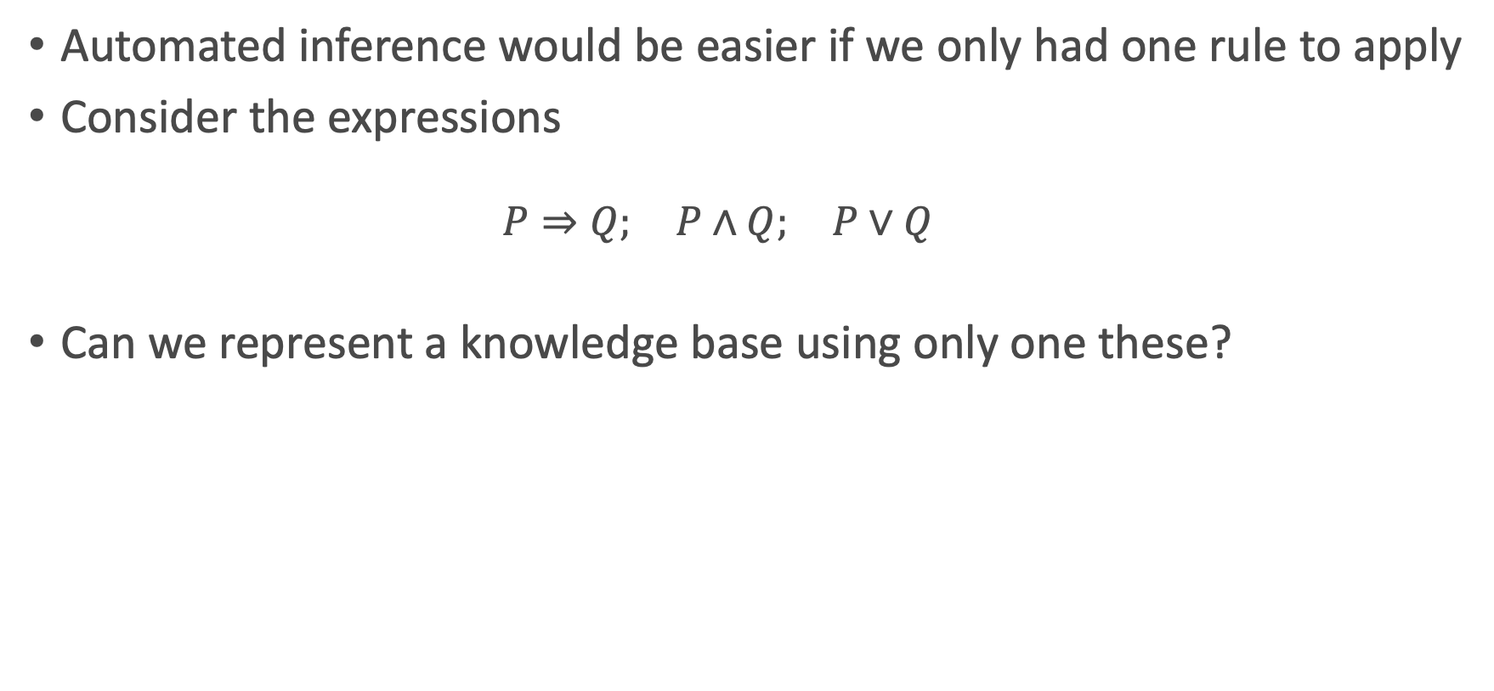
Logical Equivalencies
Automated inference would be easier if we only had one rule to apply
Consider the expressions
$$P⇒Q; P∧Q; P∨Q$$
Can we represent a knowledge base using only one these?

Slide 66
Rule Based Systems
If we can represent a Knowledge base purely in terms of material implication and negation, we only need one inference rule: modus ponens
Will allow us to prove logical statements by either:
Systematically deriving new facts until we find the one we want
Systematically exploring the known facts to establish compatibility.

Slide 67
Forward Chaining
If x eats grass and goes "moo" then x is a cow.
If x eats hay and goes "neigh" then x is a horse.
If x eats grass and goes "baa" then x is a sheep.
If x is a cow then x is brown.
If x is a horse then x is black.
If x is a sheep then x is white.
Given x=“Jeff”, we know that Jeff eats hay and Jeff goes "neigh".
What colour is Jeff? (our goal)

Slide 68
Backward Chaining
If x eats grass and goes "moo" then x is a cow.
If x eats hay and goes "neigh" then x is a horse.
If x eats grass and goes "baa" then x is a sheep.
If x is a cow then x is brown.
If x is a horse then x is black.
If x is a sheep then x is white.
Given x=“Jess”, we know that Jeff eats grass and Jeff goes ”baa".
We hypothesise “Jess is White” (the goal). Can we prove it?

Slide 69
Forward vs Backward Chaining
If x eats grass and goes "moo" then x is a cow.
If x eats hay and goes "neigh" then x is a horse.
If x eats grass and goes "baa" then x is a sheep.
If x is a cow then x is brown.
If x is a horse then x is black.
If x is a sheep then x is white.
Given x=“Jess”, we know that Jeff eats grass and Jeff goes ”baa".
“What colour is Jess?” vs “Prove Jess is White”.

Slide 70
Exercise: Automating Natural Deduction

Slide 71
MSc Artificial Intelligence
Knowledge Engineering
15 November 2023
Notes:
This colour bar is to be used for Artificial Intelligence

Slide 72
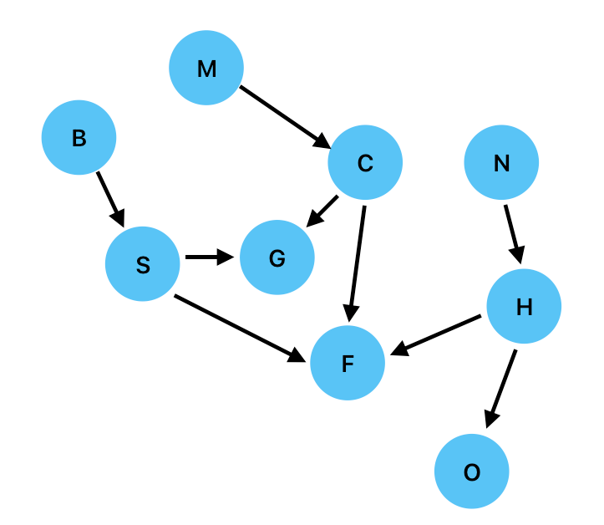
Search and Proof
1. If x goes "moo" then x is a cow.
2. If x goes "baa" then x is a sheep.
3. If x goes "neigh" then x is a horse.
4. If x is a cow then x eats grass.
5. If x is a sheep then x eats grass.
6. If x is a horse then x eats oats.
7. If x is a cow then x has four legs.
8. If x is a sheep then x has four legs.
9. If x is a horse then x has four legs.
Jenny has four legs.
Where do we start??

Slide 73
Search and Proof
Inference in rule based systems is equivalent to search on a directed graph
A proof corresponds to finding a path in the graph between the premises and the goal.
In forward chaining, we start with the premises
“Jack goes ‘Moo’. What does Jack eat?”
In backward chaining, we start with the goal
“Jack goes ‘Moo’. Does Jack eat Oats?”
Both cases require us to traverse the graph. How to do this systematically?

Slide 74
Breadth-First Search (Forward Chaining)

Slide 75
Breadth-First Search (Backward Chaining)

Slide 76
Depth-First Search (Forward Chaining)

Slide 77
Depth-First Search (Backward Chaining)

Slide 78
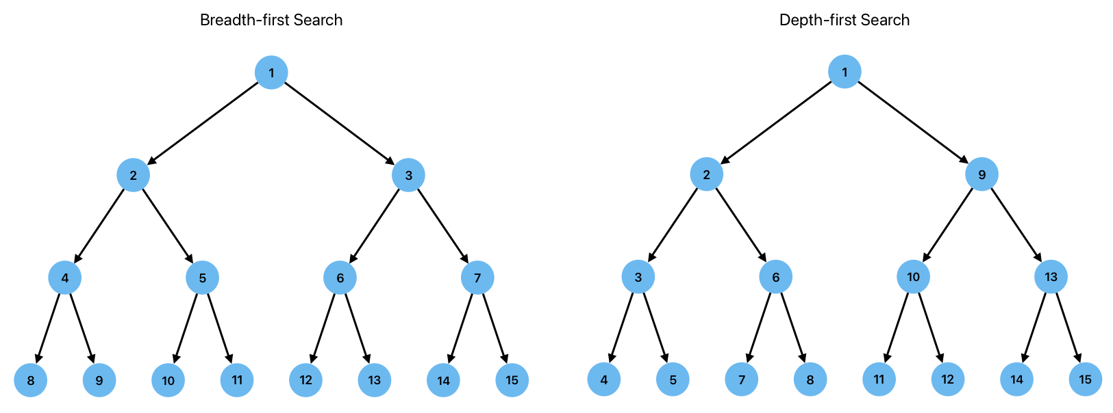
Breadth vs Depth-First Search

Slide 79
Exercise: Proof and Search

Slide 80
Day 2 Wrap-up
Logic programming with Kanren
Forward and Backward Chaining
Proof and Search
Tomorrow:
First Order Logic
LLMs and Reasoning
The Assessment

Slide 81
MSc Artificial Intelligence
Knowledge Engineering
15 November 2023
Notes:
This colour bar is to be used for Artificial Intelligence

Slide 82
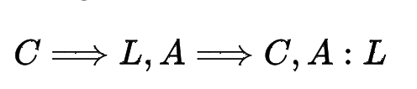
A Problem with Propositions
All computer scientists are logical
Alan is a computer scientist
Therefore Alan is logical
We can represent this easily this in propositional logic
What about another computer scientist, Grace?
Our argument above is about Alan.
We need to construct another argument for Grace.
What about Physicists, Philophers, Classicists?
This seems……wasteful

Slide 83
First Order Logic
Even worse….
All computer scientists are logical
Some computer scientists are Irish
Therefore, some computer scientists are logical and Irish.
Do our tools allow us to prove that this is a valid argument?
These are all propositions, but they use quantifiers (all, some)
No natural mechanisms for working with these in propositional logic.
Careful definitions of the sentences has got us out of trouble so far, but won’t work here.
We need some new mechanisms.

Slide 84
First Order Logic
Propositions have to be unconditionally True or False
Ahmed had the Stew
Niamh had the Dhal
First order logic introduces mechanisms that allow us to include and reason about
Variables (Ahmed, Niamh, Lorapix, Acidulitis etc)
Quantifiers (all, some etc)
Predicates (Ordered dinner, is a symptom of)

Slide 85
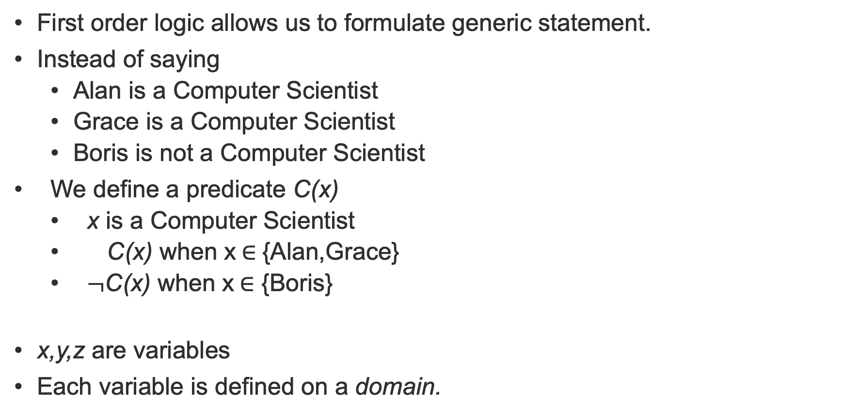
Variables and Predicates
First order logic allows us to formulate generic statement.
Instead of saying
Alan is a Computer Scientist
Grace is a Computer Scientist
Boris is not a Computer Scientist
We define a predicate C(x)
x is a Computer Scientist
C(x) when x$∈${Alan,Grace}
$¬$C(x) when x$∈$ {Boris}
x,y,z are variables
Each variable is defined on a domain.

Slide 86
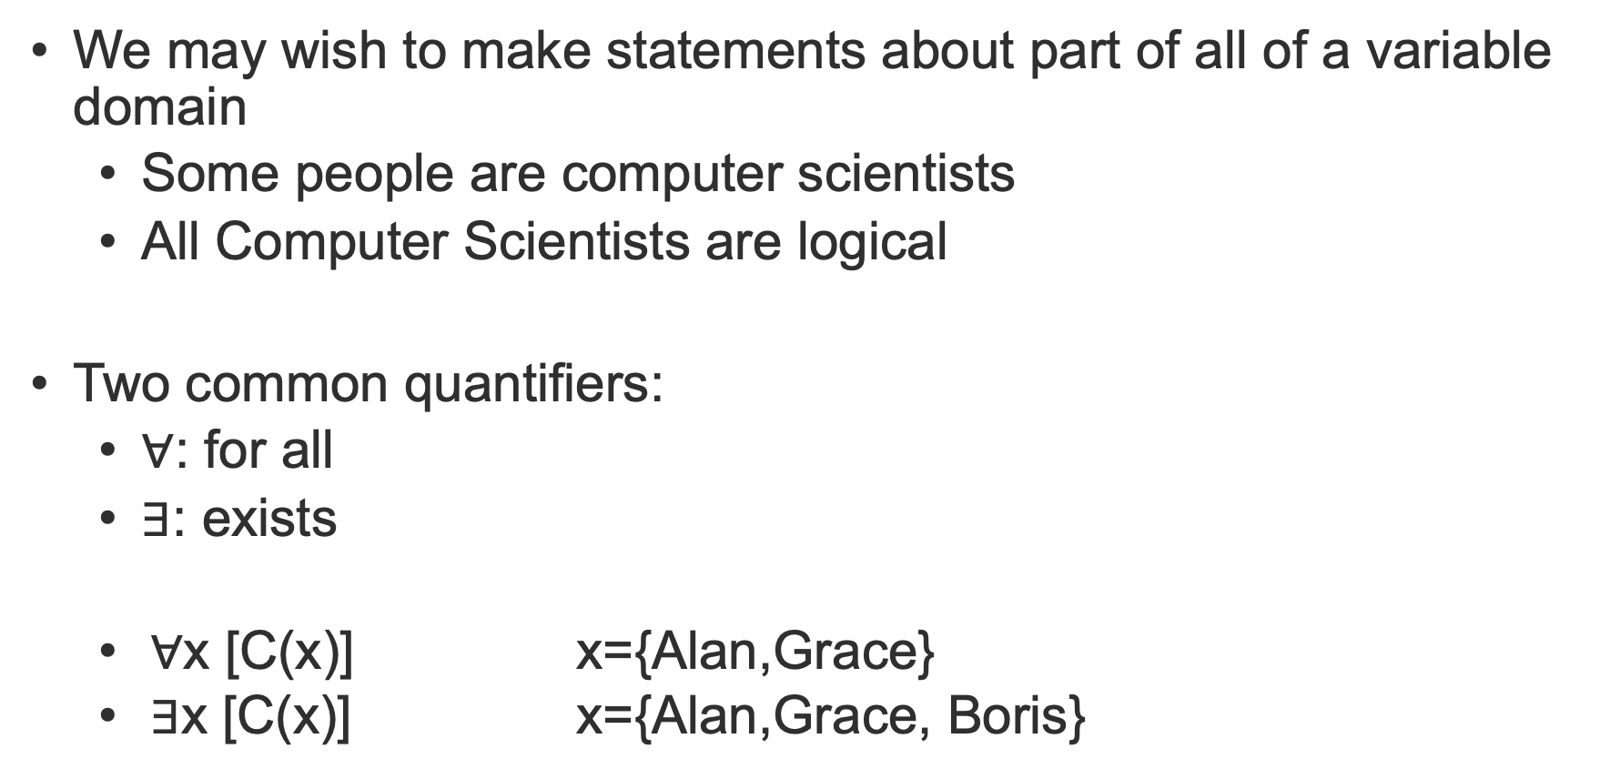
Quantifiers
We may wish to make statements about part of all of a variable domain
Some people are computer scientists
All Computer Scientists are logical
Two common quantifiers:
$∀$: for all
$∃$: exists
$∀$x [C(x)] x={Alan,Grace}
$∃$x [C(x)] x={Alan,Grace, Boris}

Slide 87
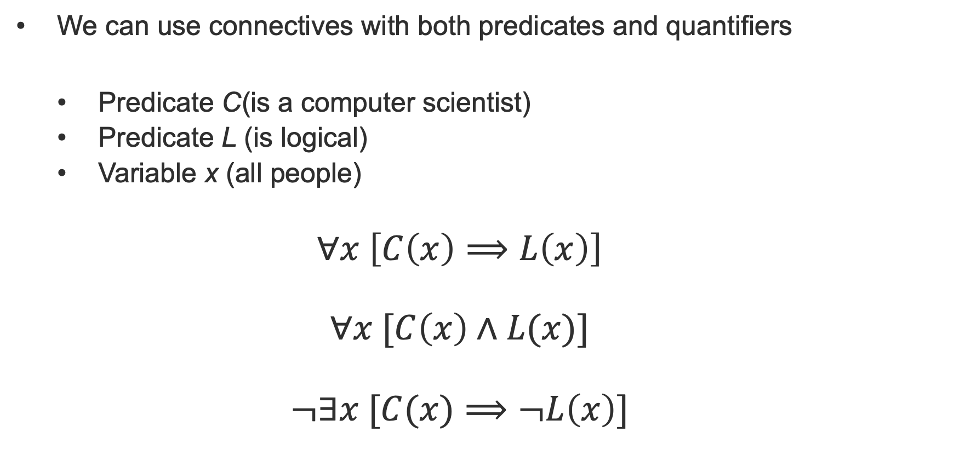
Logical Connectives
We can use connectives with both predicates and quantifiers
Predicate C(is a computer scientist)
Predicate L (is logical)
Variable x (all people)
$$∀x \left[C\left(x\right)⟹L\left(x\right)\right]$$
$$∀x [C\left(x\right)∧L(x)]$$
$$¬∃x [C(x)⟹¬L\left(x\right)]$$

Slide 88
Exercise: First Order Logic

Slide 89
MSc Artificial Intelligence
Knowledge Engineering
15 November 2023
Notes:
This colour bar is to be used for Artificial Intelligence

Slide 90
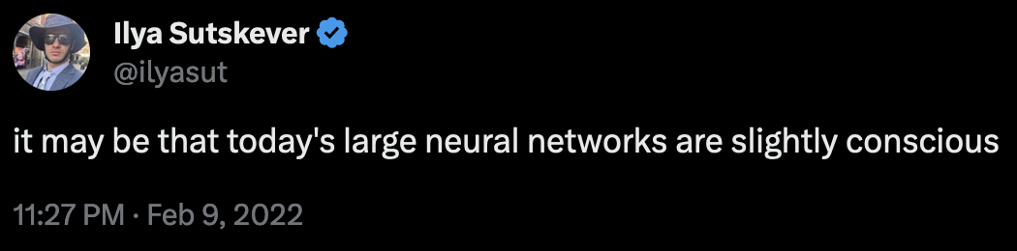
In the era of LLMs do we need all this?
Large language models like Chatgpt, Llama, Bard, Claude can understand and generate astonishingly coherent natural language
Bold claims have been made about the capabilities of these systems
Do these claims stack up?
Can LLMs reason?

Slide 91
How do LLMs work?
[You will learn more about this next term in “Natural Language Processing”]
LLMs are generative language models
Trained to generate sequences of words conditioned on
A prompt supplied by us
What they have already generated
Essentially they predict the next word in a sequence by sampling from the distribution of possible words.
Why do they work so well?
Very large neural network models
Self-supervised generative pre-training – learning to predict the training data itself
Trained on vast amounts of data

Slide 92
How do LLMs work?
Why do some people think this might lead to AGI?
Massively improved ability to generate text over previous approaches
Far better at the “Turing Test” than previous efforts
Some evidence that its output is a synthesis of its training data not a regurgitation
Wishful thinking!

Slide 93
How do LLMs work?
Why do some people think this might lead to AGI?
Massively improved ability to generate text over previous approaches
Far better at the “Turing Test” than previous efforts
Some evidence that its output is a synthesis of its training data not a regurgitation
Wishful thinking!

Slide 94
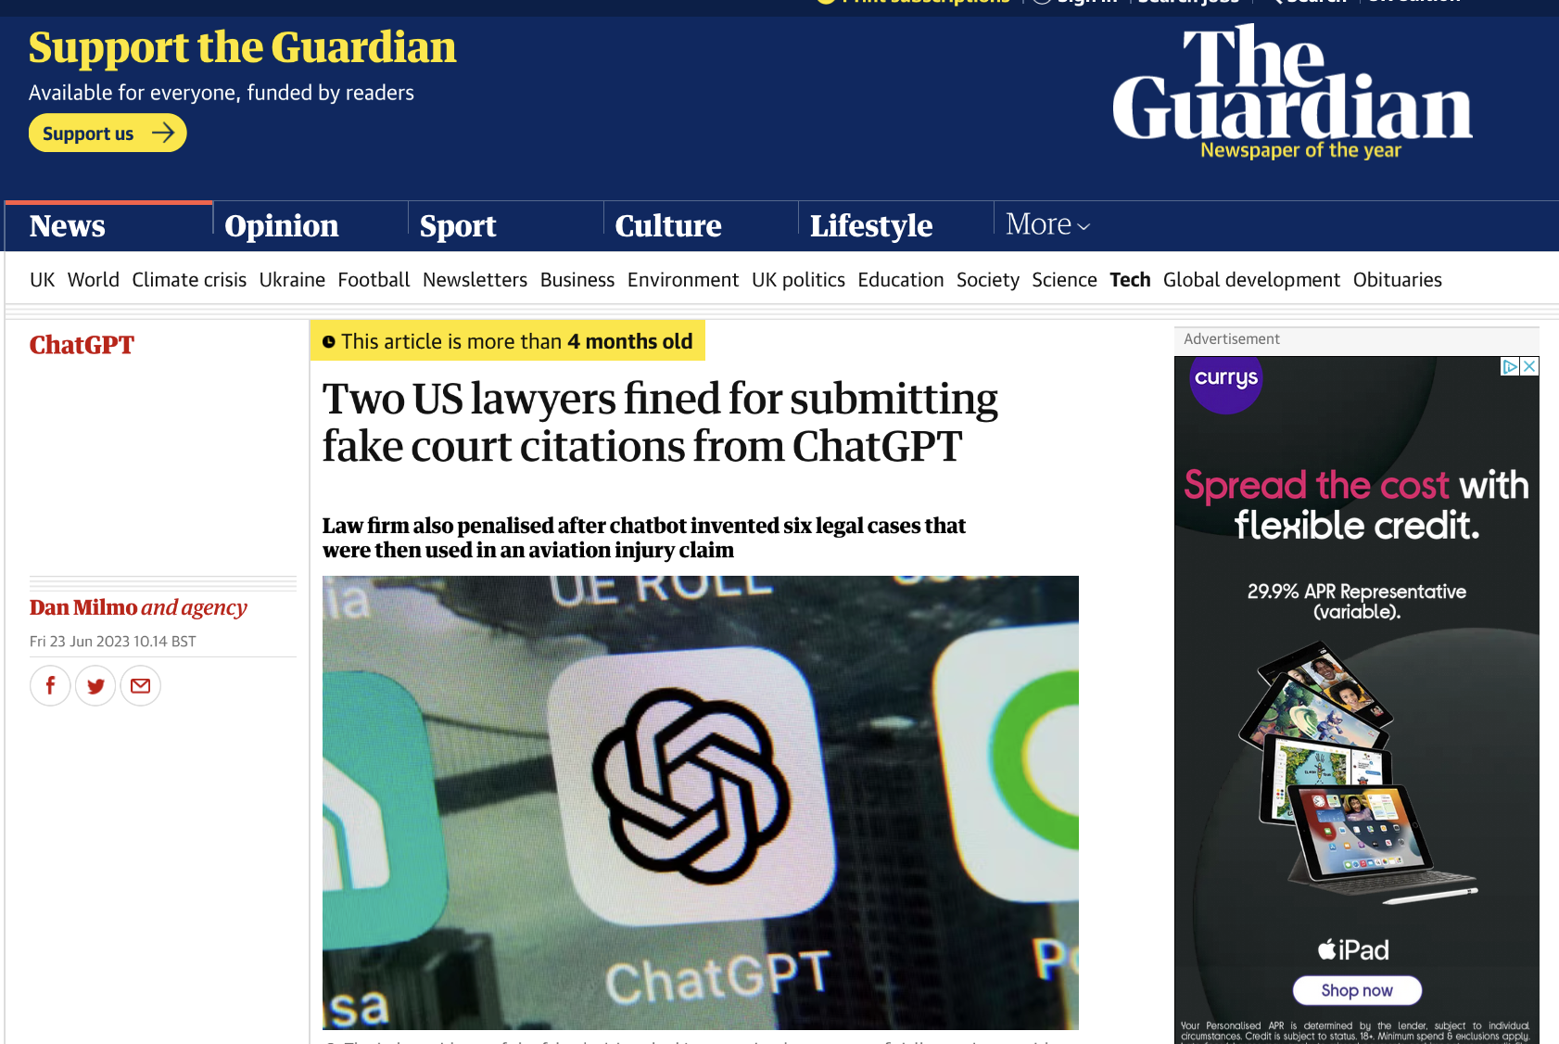
Can we trust it?

Slide 95

Leading questions?

Slide 96
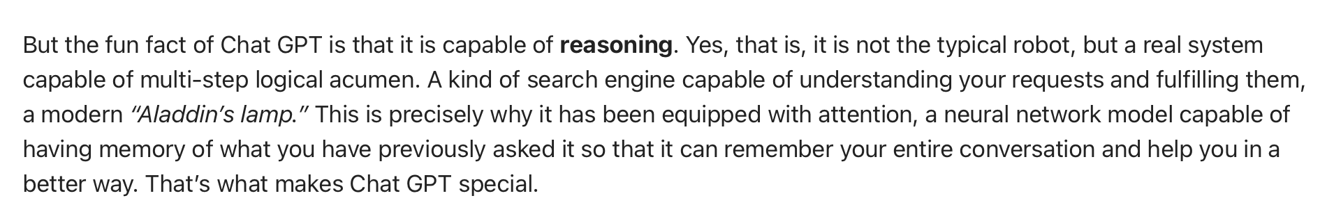
Bold Claims
Let’s find out if this is true

Slide 97
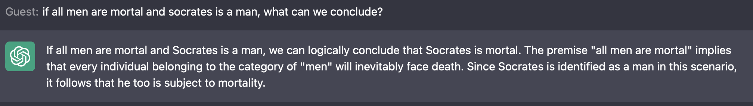
An old friend…
Can chatgpt do modus ponens?
All men are mortal
Socrates is a man…

Slide 98
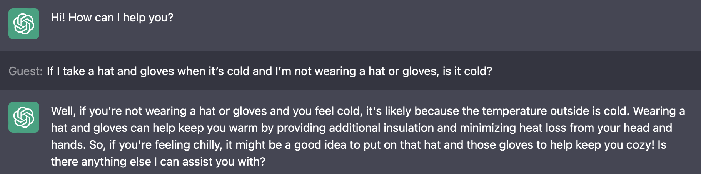
More complex arguments
If I take a hat and gloves when it’s cold and I’m not wearing a hat or gloves, is it cold?

Slide 99
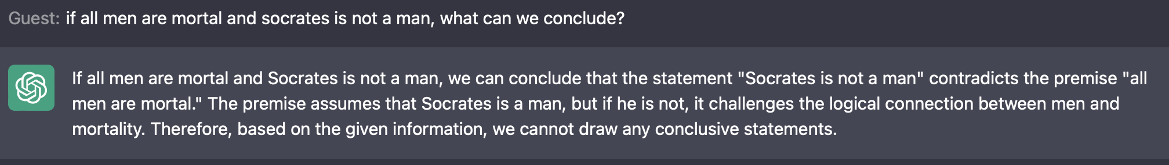
An old friend…
Can we tempt it into a logical fallacy?
All men are mortal
Socrates is not a man…

Slide 100
Exercise
Go to the exercise “Are you Logical”.
Copy and paste the first five questions (one at a time) into Chatgpt.
How does it do? Is it consistent? What sort of mistakes does it make?

Slide 101
Exercise
Go to the exercise “Elementary my dear Watson” on Monday 13 November.
Copy and paste the four parts of question 3 (one at a time) into Chatgpt. You’ll need to include the question each time.
How does it do? Is it consistent? What sort of mistakes does it make?

Slide 102
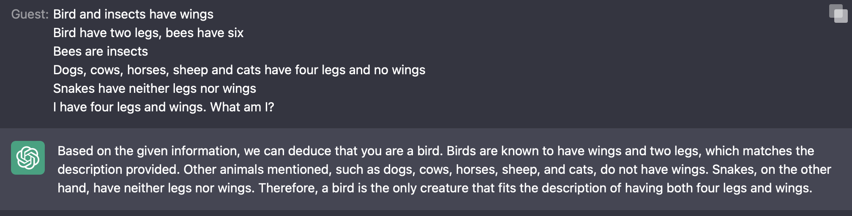
A simple riddle
Bird and insects have wings
Bird have two legs, bees have six
Bees are insects
Dogs, cows, horses, sheep and cats have four legs and no wings
Snakes have neither legs nor wings
I have four legs and wings. What am I?

Slide 103
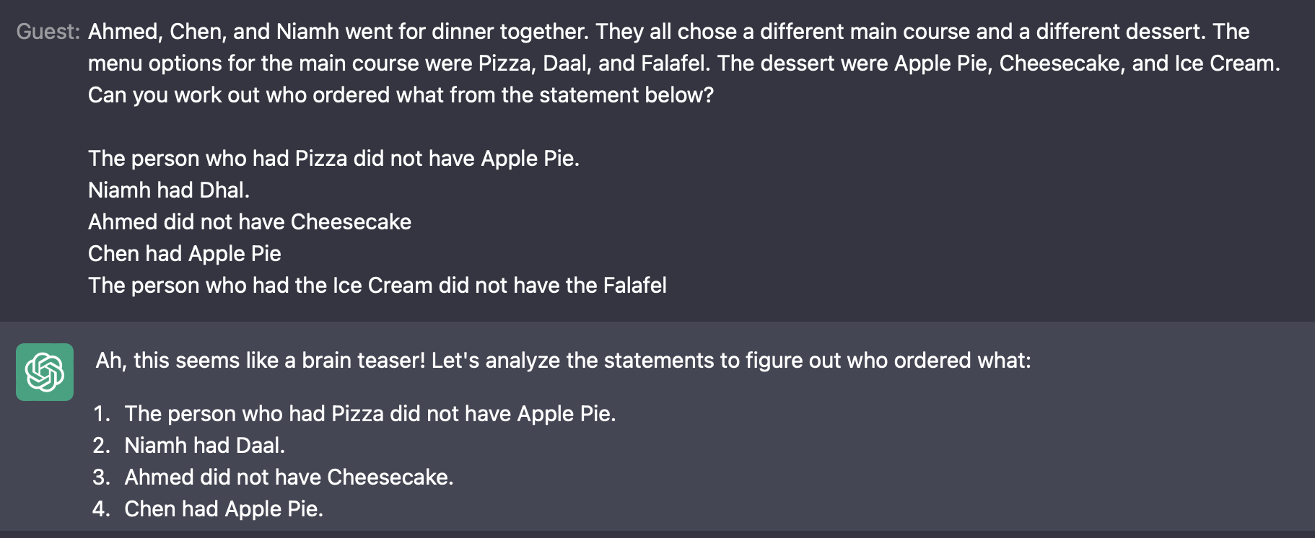
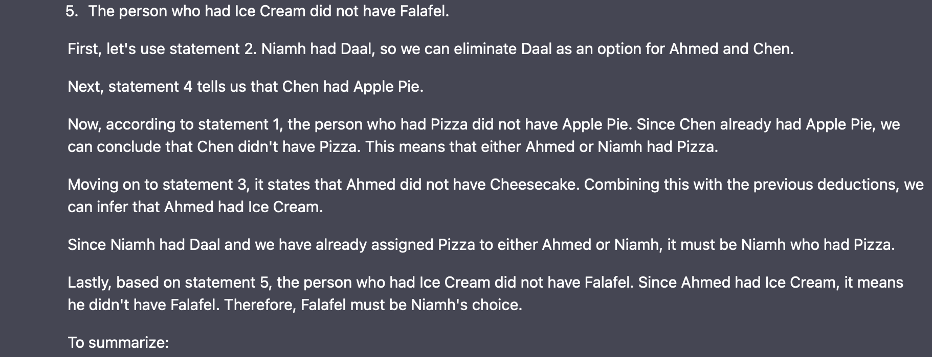


Slide 104
Challenge
Can you get ChatGPT to solve the three diners puzzle (Are you Logical, Q6)?
(You may need to edit the text to make it fit).
15-20 minutes
What sort of mistakes does it make (if it makes mistakes)?

Slide 105
Challenge
Can you get ChatGPT to solve Einstein’s Riddle (slides, Tuesday 13 November)?
(You may need to edit the text to make it fit).
15-20 minutes
What sort of mistakes does it make (if it makes mistakes)?

Slide 106
The Assignment
Now open in Canvas
Let’s take a look!

Slide 107
Day 3 Wrap-up
First Order Logic
LLMs and Reasoning
The Assessment
Next Week:
Knowledge Graphs

